Slide 1

Sustainability Support for Education:
Governor’s Special
Notes:
LIZZIE
Hello and welcome to the Sustainability Support for Education Action for Climate session.
Couple of minutes
Thank you for joining us. Today we’re going to be taking you through the DfE funded sustainability support for education Hub.

Slide 2




Housekeeping
Please keep yourself on mute
Feel free to introduce yourself in the chat
Feel free to have your camera on or off
Put questions in the chat at any time
Notes:
LIZZIE
Introduce Tim (Department for Education lead) or Gayle (Head of Sustainability Support) who’s going to talk a little bit about the context of the Sustainability Support for Education Hub and the wider Department for Education strategy.

Slide 3
Today you will…
Be introduced to Sustainability Support for Education and have a demo of the site
Been taken through sign up and create an account
Have a look at some actions to get you started
Notes:
LIZZIE
The purpose of the session is to show you how the Hub works and to give you the time to sign up and create an account, find aims and actions that you want to take, and to create a list that you can share with others in your setting to begin conversations on how your going to take climate action.
We’ll also give you information on accessing another of the DfE’s funded projects - the Climate Ambassadors.

Slide 4
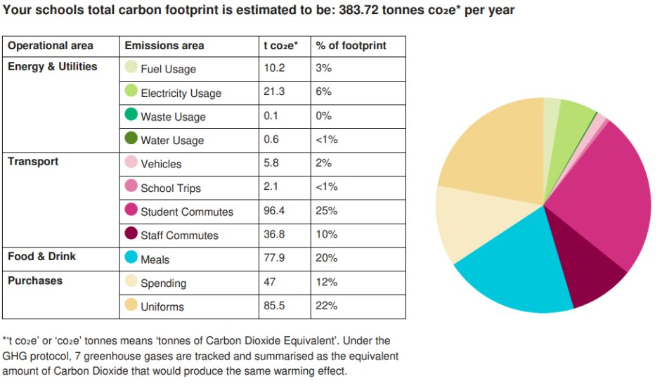
Climate Action: The what
Reduce emissions
Developing resilience to the effects of an ever changing climate
Increasing access to, and connection with nature
Climate education and skills
Notes:
LIZZIE
First, just to understand what is meant by climate action. This covers a whole range of activity, and actually the Department for Education’s Climate Change and Sustainability Strategy sets it out quite nicely into four pillars, so you have Decarbonisation and Energy Efficiency, Climate Adaptation, Biodiversity, and Climate Education Green Skills and careers. So that’s a helpful way to think about it.
And then thinking about what those pillars actually entail, well, the decarbonisation pillar is largely about how to reduce your setting’s carbon emissions. So that can be related to things like energy, or waste, or procurement or commuting and travel. And you can see an example carbon footprint on the screen that you can calculate using the Count Your Carbon tool, to help you understand what your setting’s footprint looks like, as they will all be different. So that’s something you might want to consider advising your setting to do.
And then thinking about the climate adaptation pillar, this is about how climate change events so flooding, heat stress, extreme cold and so on, how these are going to affect your people, your estate, your operations, and even your supply chain over time. So for example you might think about how to improving ventilation, shading or insulation and building in flexibility in the way you operate to help you to adapt to extreme weather. And where your setting has really young children, they are one of the most vulnerable groups when it comes to things like extreme heat and cold, so making sure you can adapt to the changing climate is really important in that context.
Climate action also includes thinking about our relationship with nature around us and how we can improve biodiversity, but also the added benefits that nature can bring for our mental health and wellbeing for both staff and children.
And finally also thinking about how we need to prepare children for climate change and its impacts through education and skills, and enabling that to be embedded as early as possible in their lives.
You will likely be doing some of this already in different forms. And so one of the most effective ways to get your setting started is to have them list all the wonderful stuff they might have previously done that links to taking climate action. Because you can use those as a springboard and inspiration for what you want to focus on next. And we will touch on this in more detail in the activity part of today’s sesison.

Slide 5
Climate Action: The why
To meet the Department for Education’s 2025 requirement for all settings to have a
Climate Action Plan
A sustainability lead
Beyond compliance there’s a bigger picture. Schools that take meaningful climate action:
See Financial Savings
Reduce energy bills with efficiency upgrades (LEDs, insulation, solar)
Cut waste and lower ongoing costs (e.g. paper, water, heating)
Enrich the Curriculum
Bring real-world relevance across ALL subjects
Promote critical thinking, systems thinking & future-focused learning
Improve Student Engagement and Leadership
Empower pupils through eco-councils and climate projects
Boost wellbeing, motivation, sense of purpose and citizenship
Enhance their Reputation and Community Trust
Be seen as a responsible, forward-thinking setting
Strengthen ties with parents, local authorities, and employers
Futureproof their School
Stay ahead of upcoming government sustainability requirements
Build resilience to future climate-related challenges
Notes:
LIZZIE

Slide 6
A free online service
A place for all educational settings to build their Climate Action Plans and do it:
Quickly: easy to navigate for time poor staff.
Easily: One stop shop, covering all 5 pillars.
Well: the highest quality resources, checked by experts.
Notes:
LIZZIE
SHOW THEM THE SITE AND TAKE A LOOK AROUND

Slide 7

Visiting the site for the first time
Notes:
LIZZIE

Slide 8
Benefits of Registering
Save actions and related resources to come back to later
Download actions to add to your Climate Action Plan
Share actions and resources that you've found with colleagues and collaborators
Input details on your setting to get more tailored suggestions
Notes:
LIZZIE
So for the first activity in today’s session, we’re going to give you some time to register. And by registering you’re going to be able to save actions and resources to come back to later, you’ll also be able to download actions to use in your Climate Action Plan. You’ll also be able to share the action and resources you find with your colleagues. So for example, if you want to speak to your catering team about how to reduce food waste, you can share any resources that will help them to do that directly with them.

Slide 9
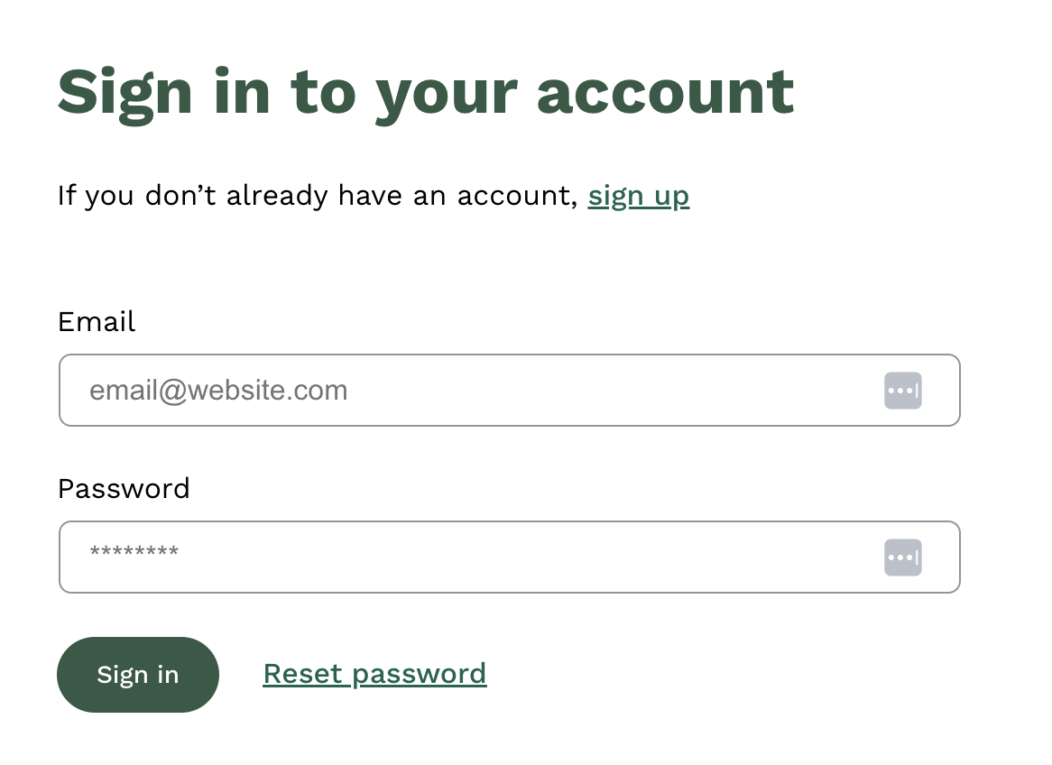
Login process
Note, you will need to verify your account
Notes:
LIZZIE
So the first step to sign up is to click on the sign up button, and you’ll need to enter your email address. And then click on the verification link that is sent to your email address.

Slide 10
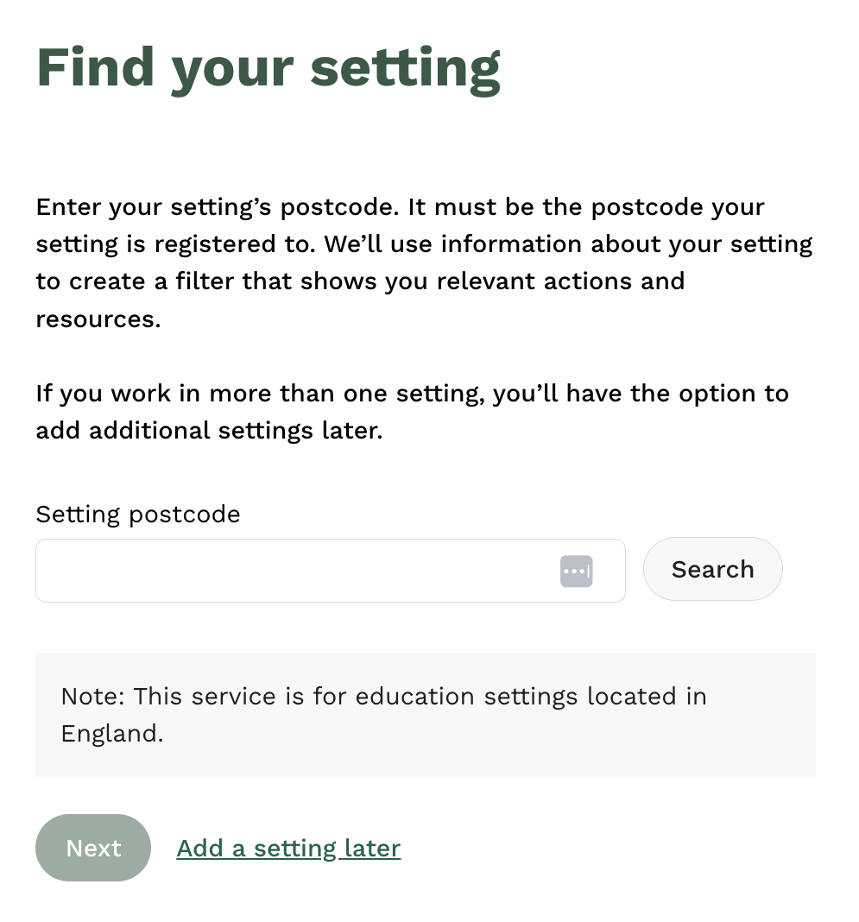
Add details on setting
Notes:
LIZZIE
Once you’ve done that you will then be prompted to provide your setting’s postcode, and this will create a profile for that setting on your account, so that you can pre-set your filters to make the actions and resources more relevant to you.

Slide 11
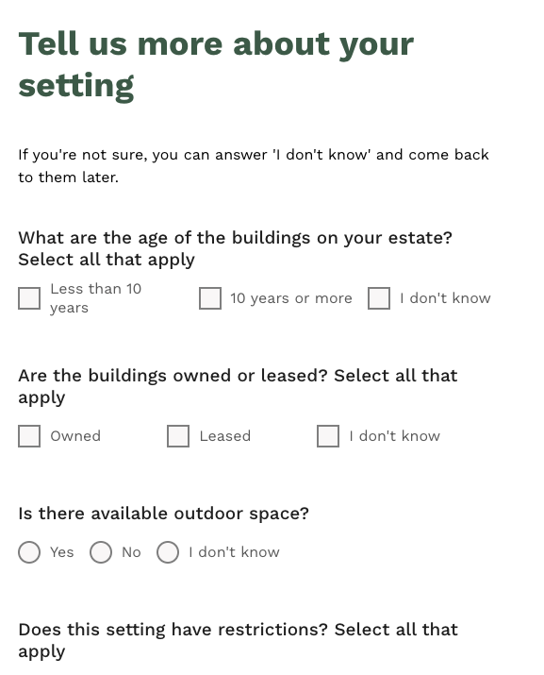
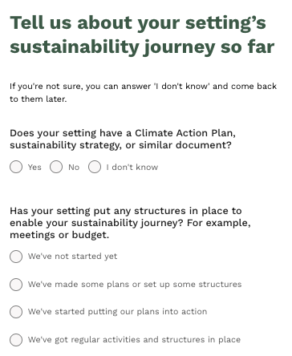
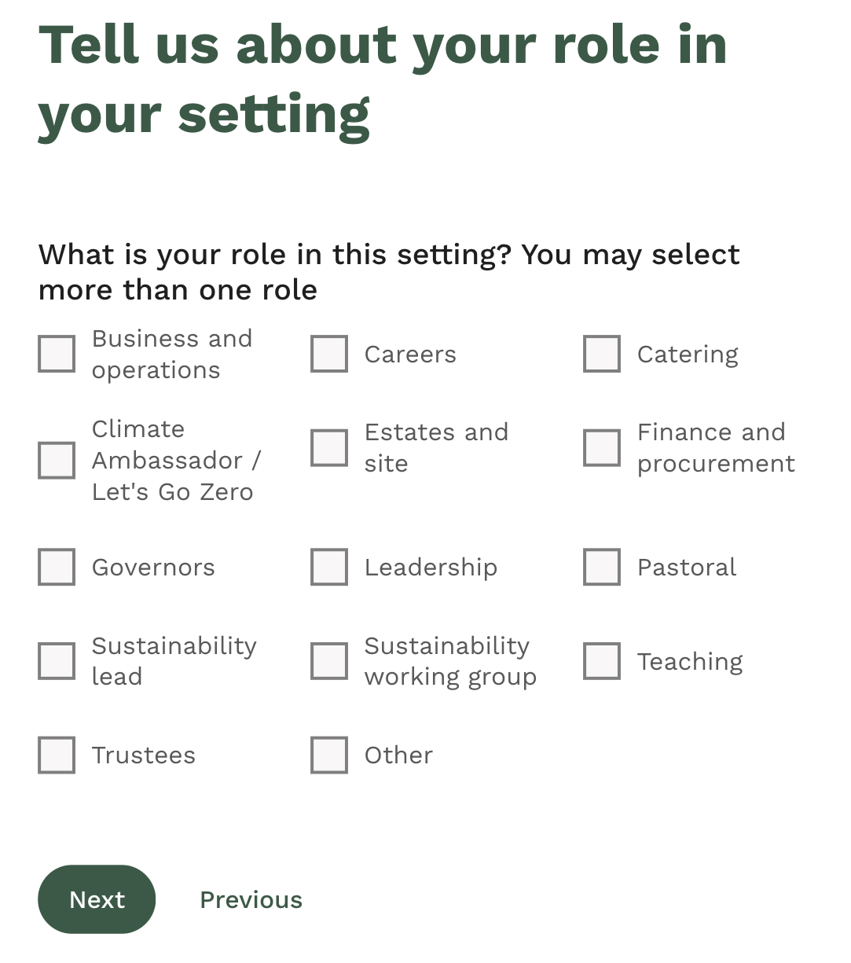
Add details on setting
Notes:
And then there are a couple of questions that will allow you to pre-set your filters, if you don’t know the answer to them you can just select I don’t know, and come back later to update them if and when you’re ready.

Slide 12
Activity 1:
Register on the service
Notes:
LIZZIE
Ok so now we will give you 5 minutes to register yourselves on the service following those steps. Amy if I can ask you to set a timer for us.

Slide 13
Actions to recommend to your settings to inspire their Climate Action Plan
Actions to help you upskill and get started on sustainability in your role
Two ways you can use the site
Notes:
BOBBY
So I’m now going to talk you through how you can use the site to get the most out of it not only for yourselves in terms of upskilling and learning about sustainability, but also how you can use it to recommend actions and resources to your setting to help inspire the actions they put into their climate action plan.

Slide 14
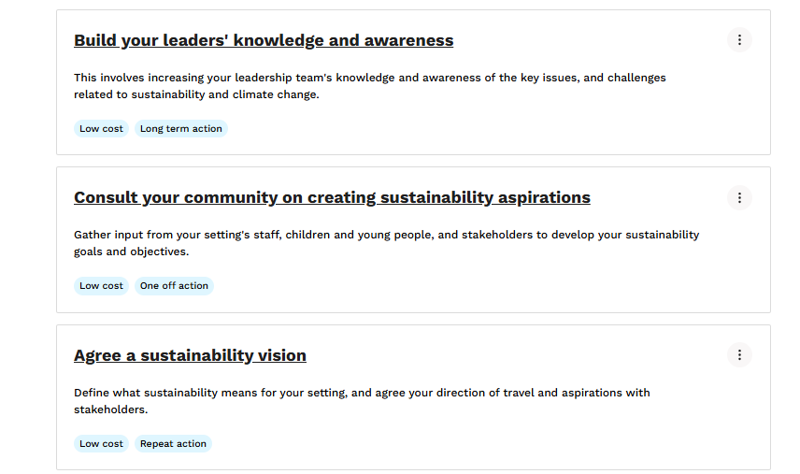
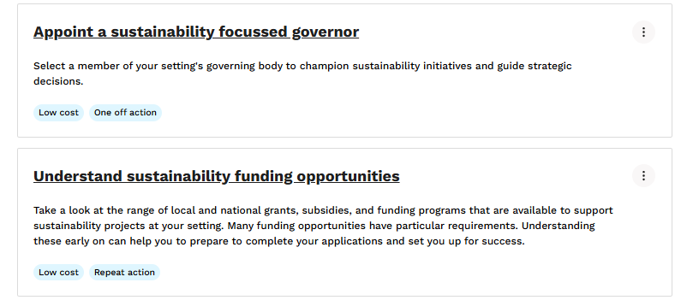
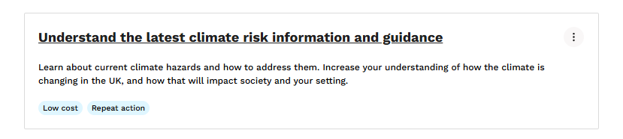
Actions to help you upskill and get started on sustainability in your role
Link to list: https://www.sustainabilitysupportforeducation.org.uk/profile/list/mEoZBUmXuIHHiTTWXKgE
Notes:
BOBBY
So for the next activity we’re going to give you some time to identify and save three actions you’re interested in, either to help upskill you, or actions that you want to recommend to your setting. Before we do that I wanted to give you some kind of inspiration and ideas on actions that you might find helpful. So here, thinking about actions to help you upskill in your role so that you can really champion climate action at your setting, we have some fantastic resources against these actions for you. So I’m just going to show you how to find these now DEMO - Journey, open the aims, save individual actions.

Slide 15
How to use the site to find actions to help you upskill
Notes:
BOBBY DEMO - journey, individual actions save.

Slide 16
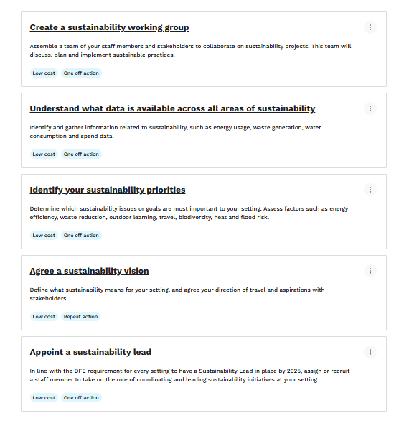
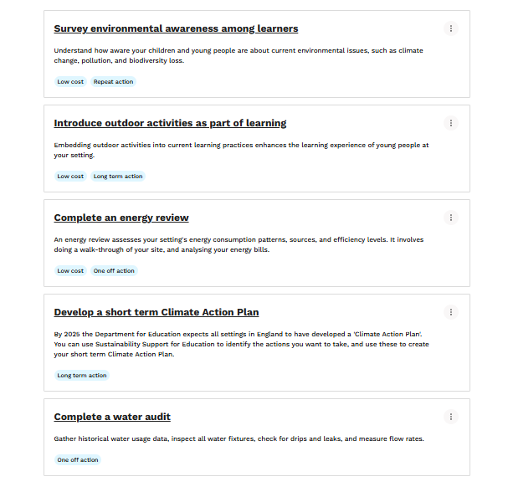
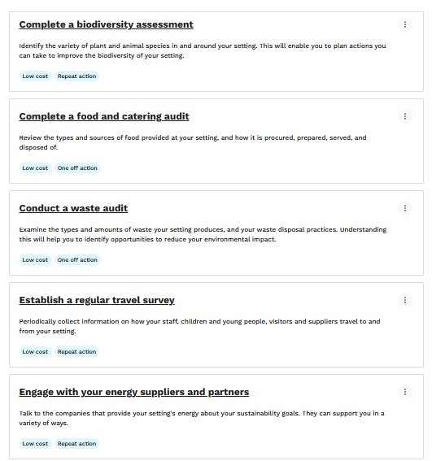
Actions to recommend to your settings to inspire their Climate Action Plan
Link to list: https://www.sustainabilitysupportforeducation.org.uk/profile/list/6WBJQL8MOxIvDpRHC9Yy
Notes:
BOBBY
And then thinking now about actions that you might find helpful to recommend to your settings to inspire their climate action plan. I just wanted to showcase the variety of actions that settings can be thinking about. And you can see that these cover a range of topics, from waste to food to energy. So now I’m going to show you how to use the topics to find actions like these and save them to a list.

Slide 17
How to use the site to find actions to help you upskill
Notes:
BOBBY DEMO TOPICS - waste, energy

Slide 18
Identify some actions and save to a list
Notes:
BOBBY
Ask them to have a little explore now and identify some actions that you like the look of and then save them to a list, following the steps I’ve just gone through. And I think we’re going to give you 8 minutes for this activity. While you’re completing this activity, if its helpful we are going to post links to the lists we have already created on upskilling and recommendations for settings in the chat, so you can use those if they feel helpful to you, but do also take the time to have a play around and familiarise yourself with the site.

Slide 19
Identify one person to share your list with
Notes:
BOBBY
And now, for the final activity of today, I’m going to do a quick demo of how to share your list with others in your setting so that you can send them your recommended actions and start having conversations about what your setting might want to prioritise so that you can build your climate action plan.
DEMO
So what we’d like you to do is think of one person in your setting that you want to share your list with, if you made a list of actions to recommend to your setting. And please could you share the role of that person in the chat when you’ve decided.
And can I ask for 1 minute on the timer for us thank you.

Slide 20




In Summary
For online support to:
- Identify sets to take for your action plan
- Access resources to help you take action
For in person, expert support to help develop and implement your plan
For curriculum linked resources and hands-on activities that empower students to transform your grounds
Notes:
Now you have your topics of focus and have chosen some actions and you can start to share them with your colleagues and begin those conversations which is fantastic. What we also want to do is highlight other organisations that can help you to make progress on your climate action journey. So the first of those is an organisation called Let’s Go Zero and they offer in person support to help you develop your climate action plan. Similarly there is also the climate ambassadors scheme which we will show you how to register your interest with today, and they can also provide in person expertise to help you complete the aims you’ve identified today. Finally there is also the National Education Nature Park and they offer an online process that will help your school to improve their nature and biodiversity, in conjunction with learning.

Slide 21
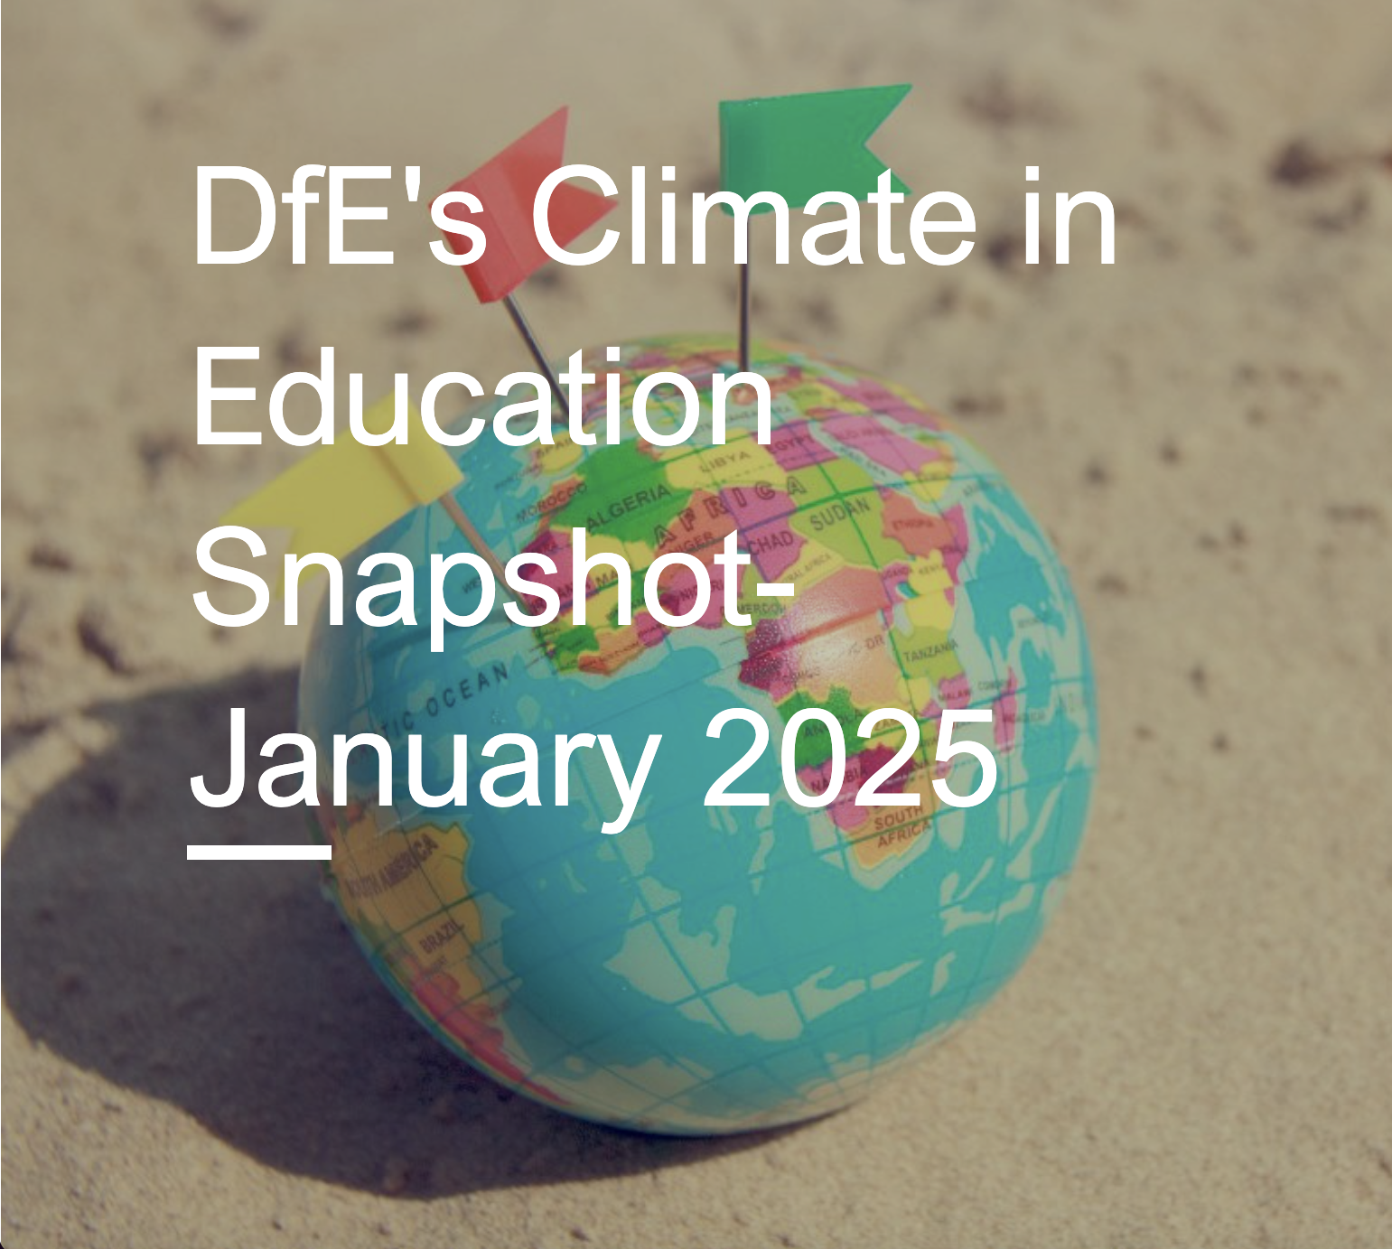
DfE snapshot
Receive news and updates from the Department for Education about sustainability related topics. Sign up here
Notes:
And finally before we move onto questions, you can also sign up to the DfE’s snapshot to stay updated on sustainability related topics and news.

Slide 22
Questions

Slide 23
Further Events
We are running more of these events in the future, and have one more EY specials coming up. Click here for more details.
Please connect on LinkedIn for the latest updates and events.
Notes:
Include the links to starter packs

Slide 25
Climate Action: The how
The role of a governor: Being the critical friend

